Slide 1
Research Update 8/15/2023
John Lee

Slide 2
Model Selection
Boundary Condition Tuning
Junctional Linear Correction
Neural Network Training
Training Data Generation
Stenosis Param/ Artificial Stenosis

Slide 3
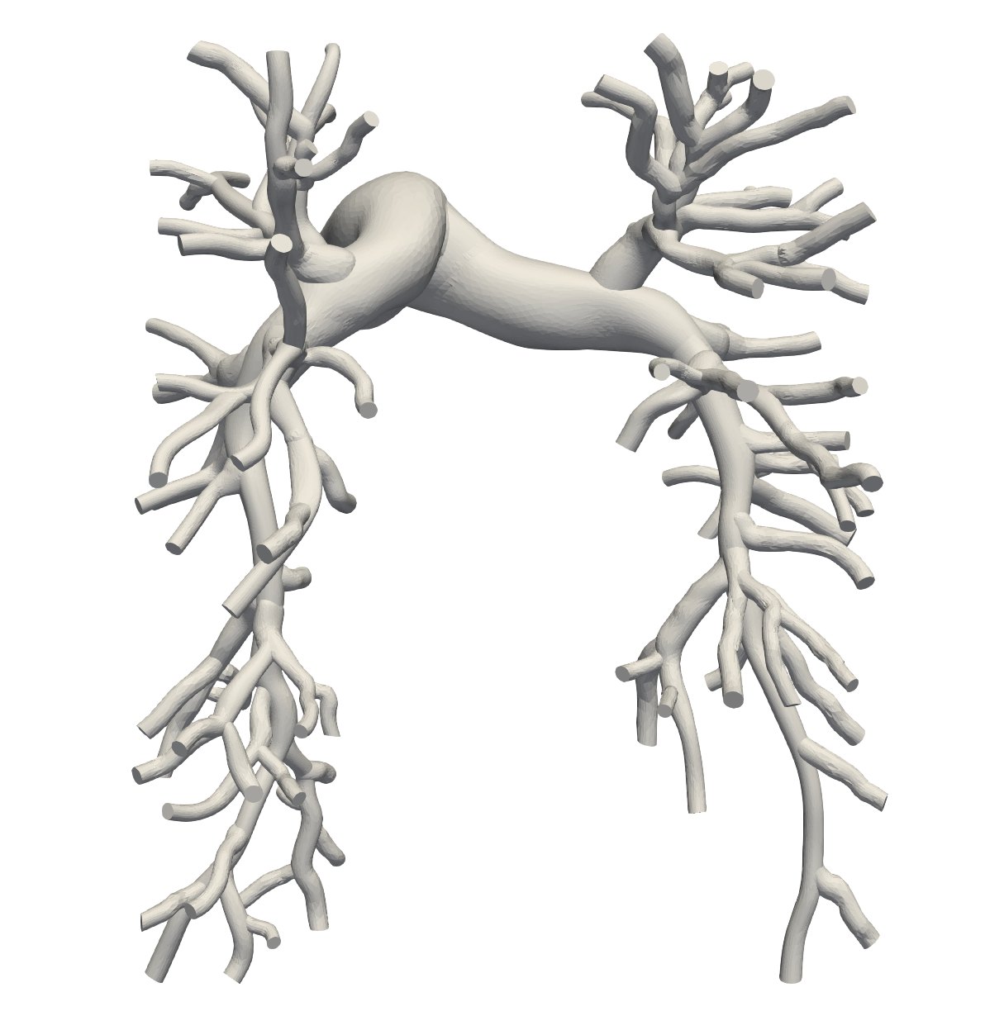
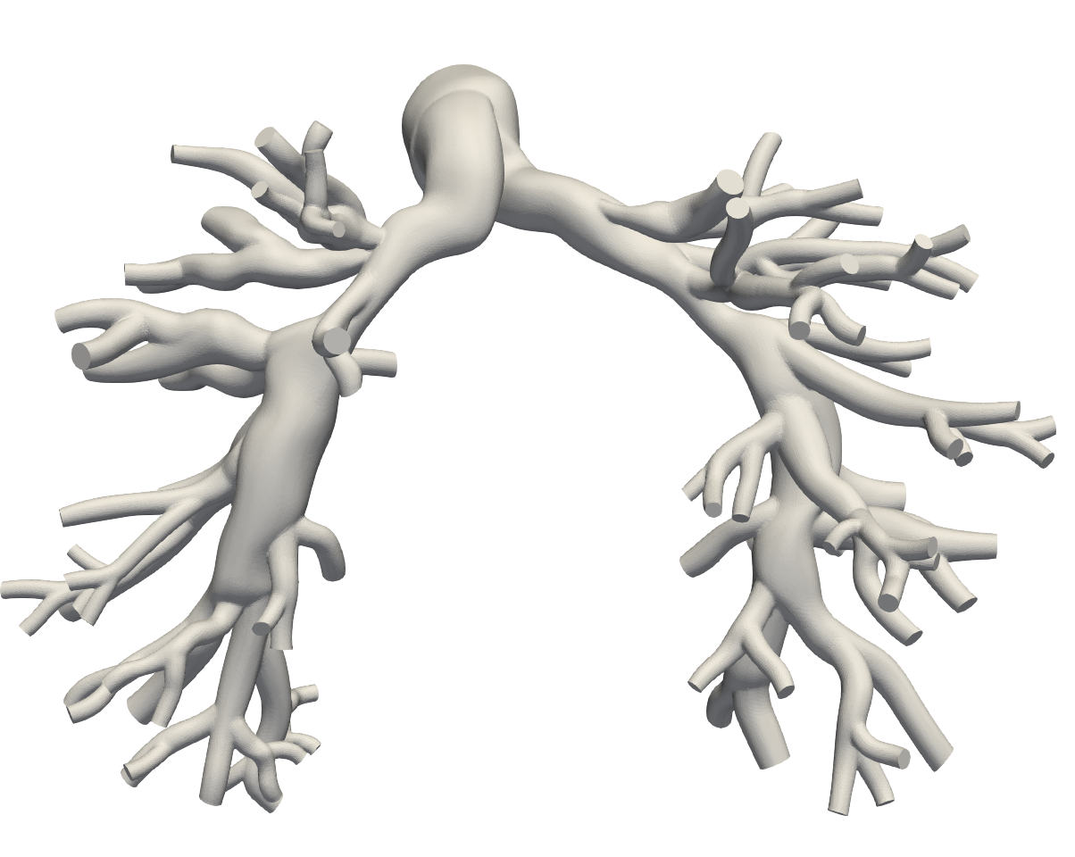
Model Selection
Healthy Model is selected to demonstrate special cases
Stenosis only in vessels
Large # of repair targets = High dimensional problem
Diseased model demonstrates general solutions
Healthy Model
Diseased Model

Slide 4
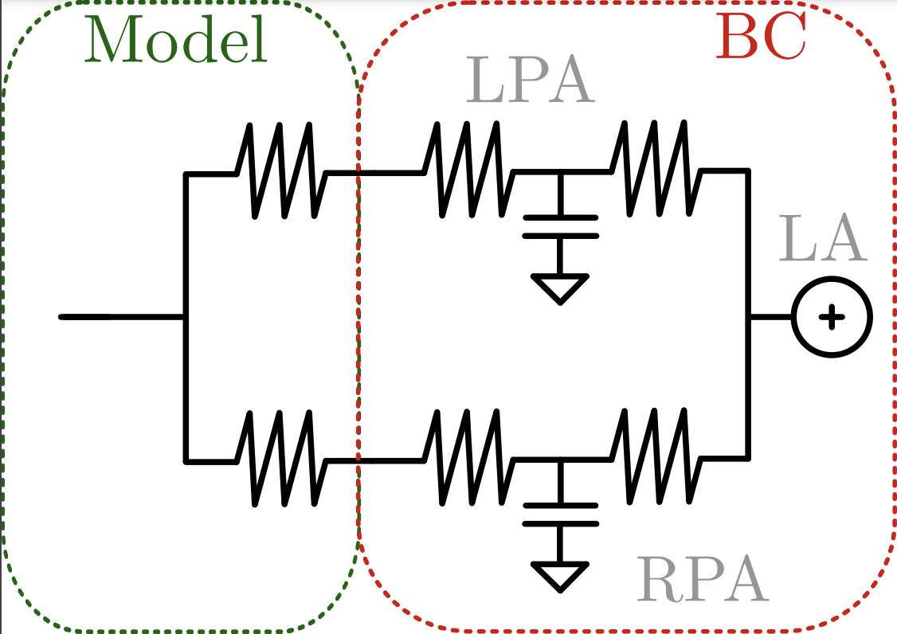
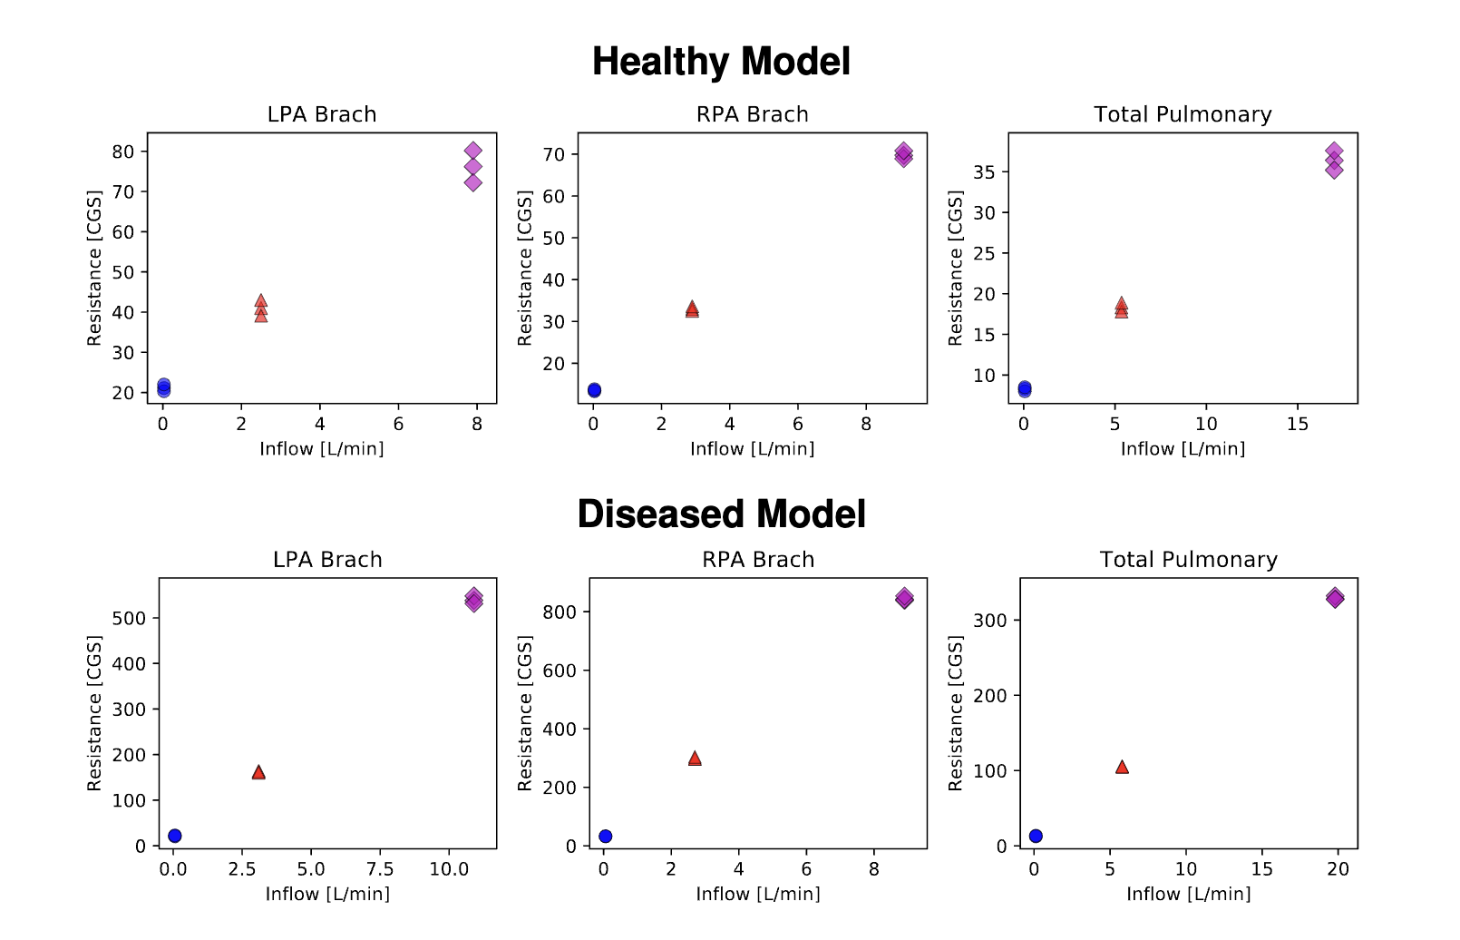
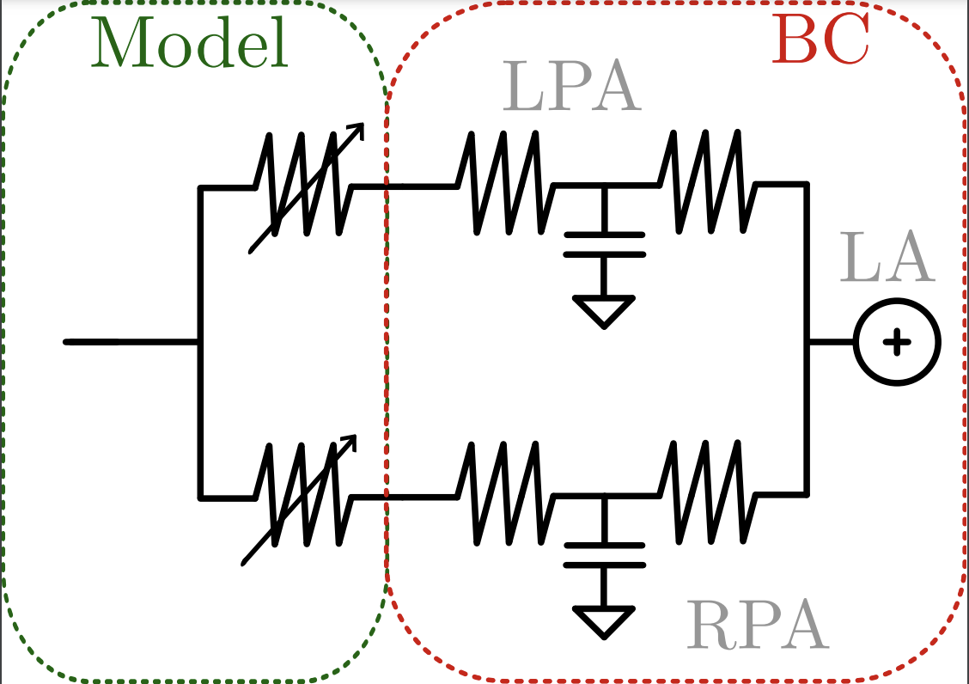
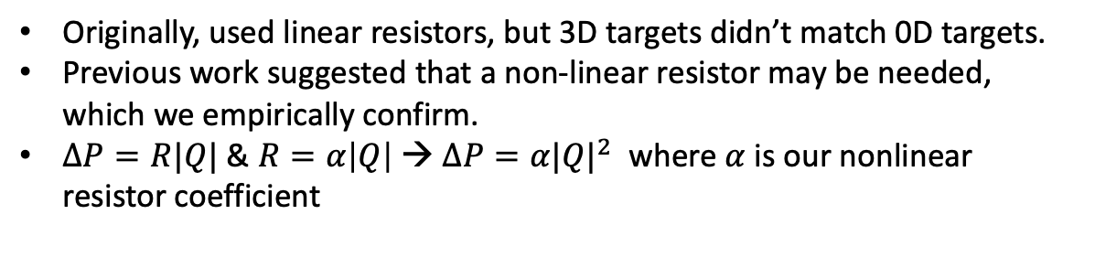
Boundary Condition Tuning
Originally, used linear resistors, but 3D targets didn’t match 0D targets.
Previous work suggested that a non-linear resistor may be needed, which we empirically confirm.
$ΔP=R|Q|$ & $R=α\left|Q\right|$ → $ΔP=α{|Q|}^{2}$ where $α$ is our nonlinear resistor coefficient

Slide 5
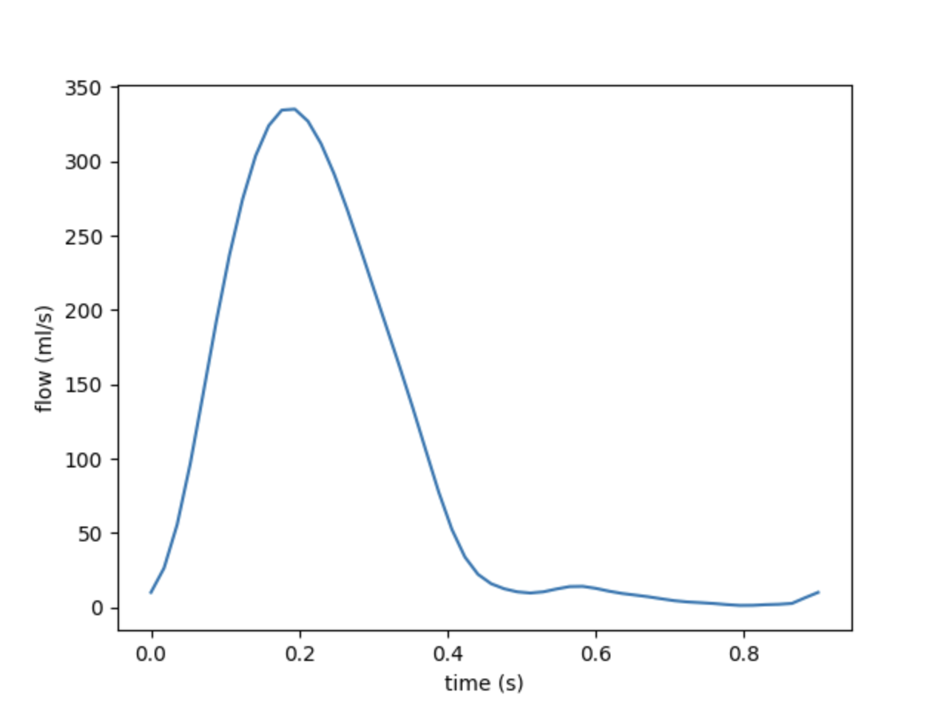
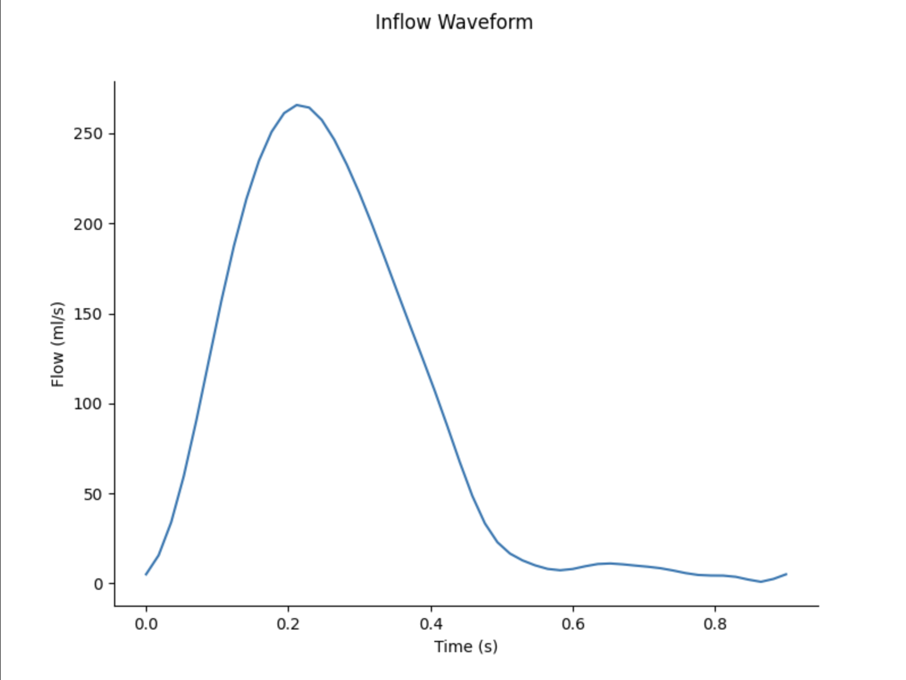
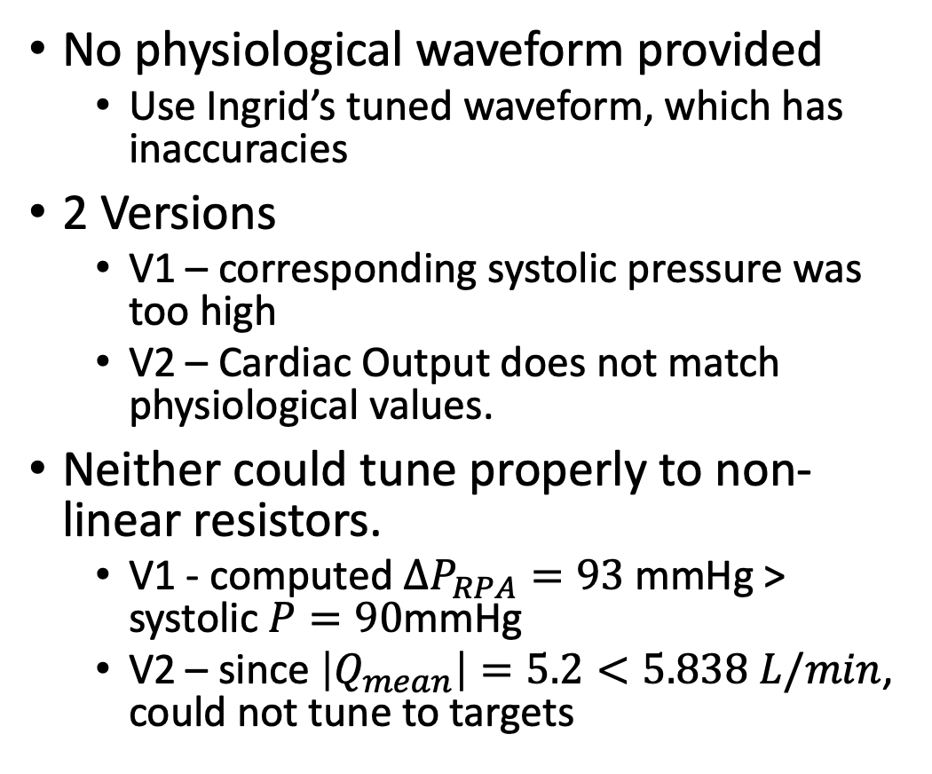
BC tuning Problems
No physiological waveform provided
Use Ingrid’s tuned waveform, which has inaccuracies
2 Versions
V1 – corresponding systolic pressure was too high
V2 – Cardiac Output does not match physiological values.
Neither could tune properly to non-linear resistors.
V1 - computed $ΔP_{RPA}=93$mmHg > systolic $P=90$mmHg
V2 – since $\left|Q_{mean}\right|=5.2<5.838 L/min$, could not tune to targets
V1 →
V2 →

Slide 6
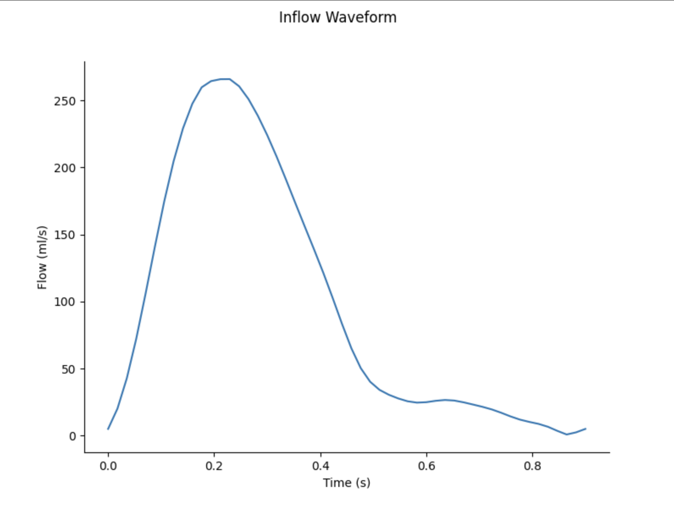
BC tuning Solution
V2 + sinusoid correction (right)
Could also use a 4th order equation correction, but it doesn’t look as nice
Compute CO difference
Split between two sinusoids (0 – systolic) & (systolic – diastolic)
Final CO = 5.90 vs 5.838 L/min target

Slide 7
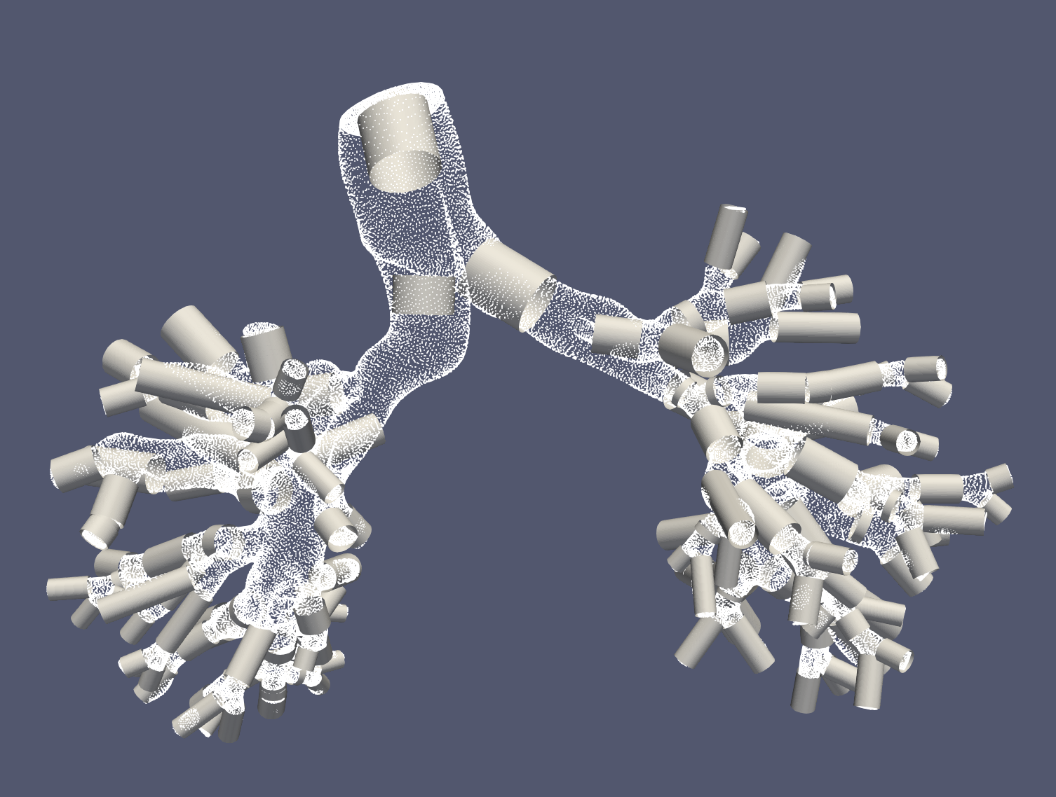
Junctional Linear Correction
Changes
Unified Correction
Perform a linear correction on every junction
Split Correction
Perform 3 separate linear corrections on the junctions in MPA, RPA and LPA trees
Split Correction ALL
Split Correction, but on all vessels, not just junctions
Increased Robustness and accuracy
Addresses problem of junctional modeling in 0D models

Slide 8
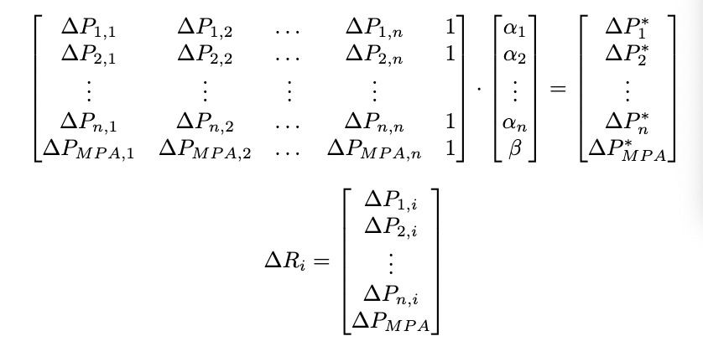

Slide 9
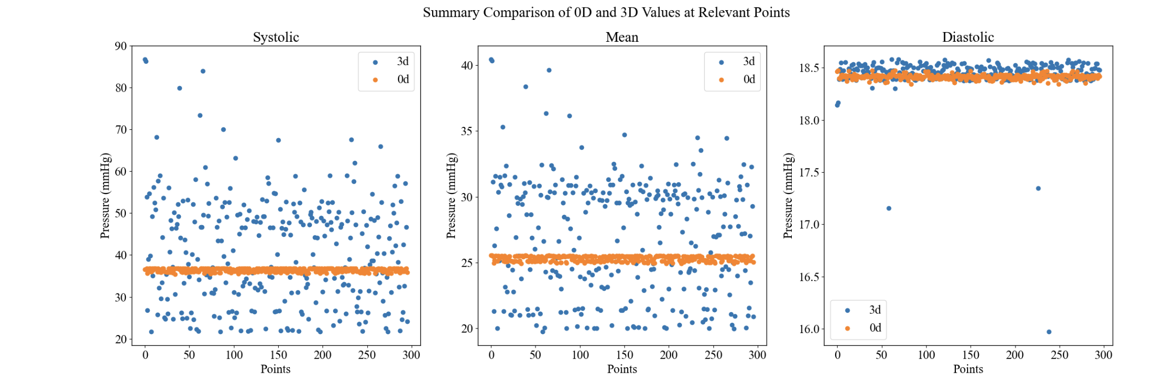
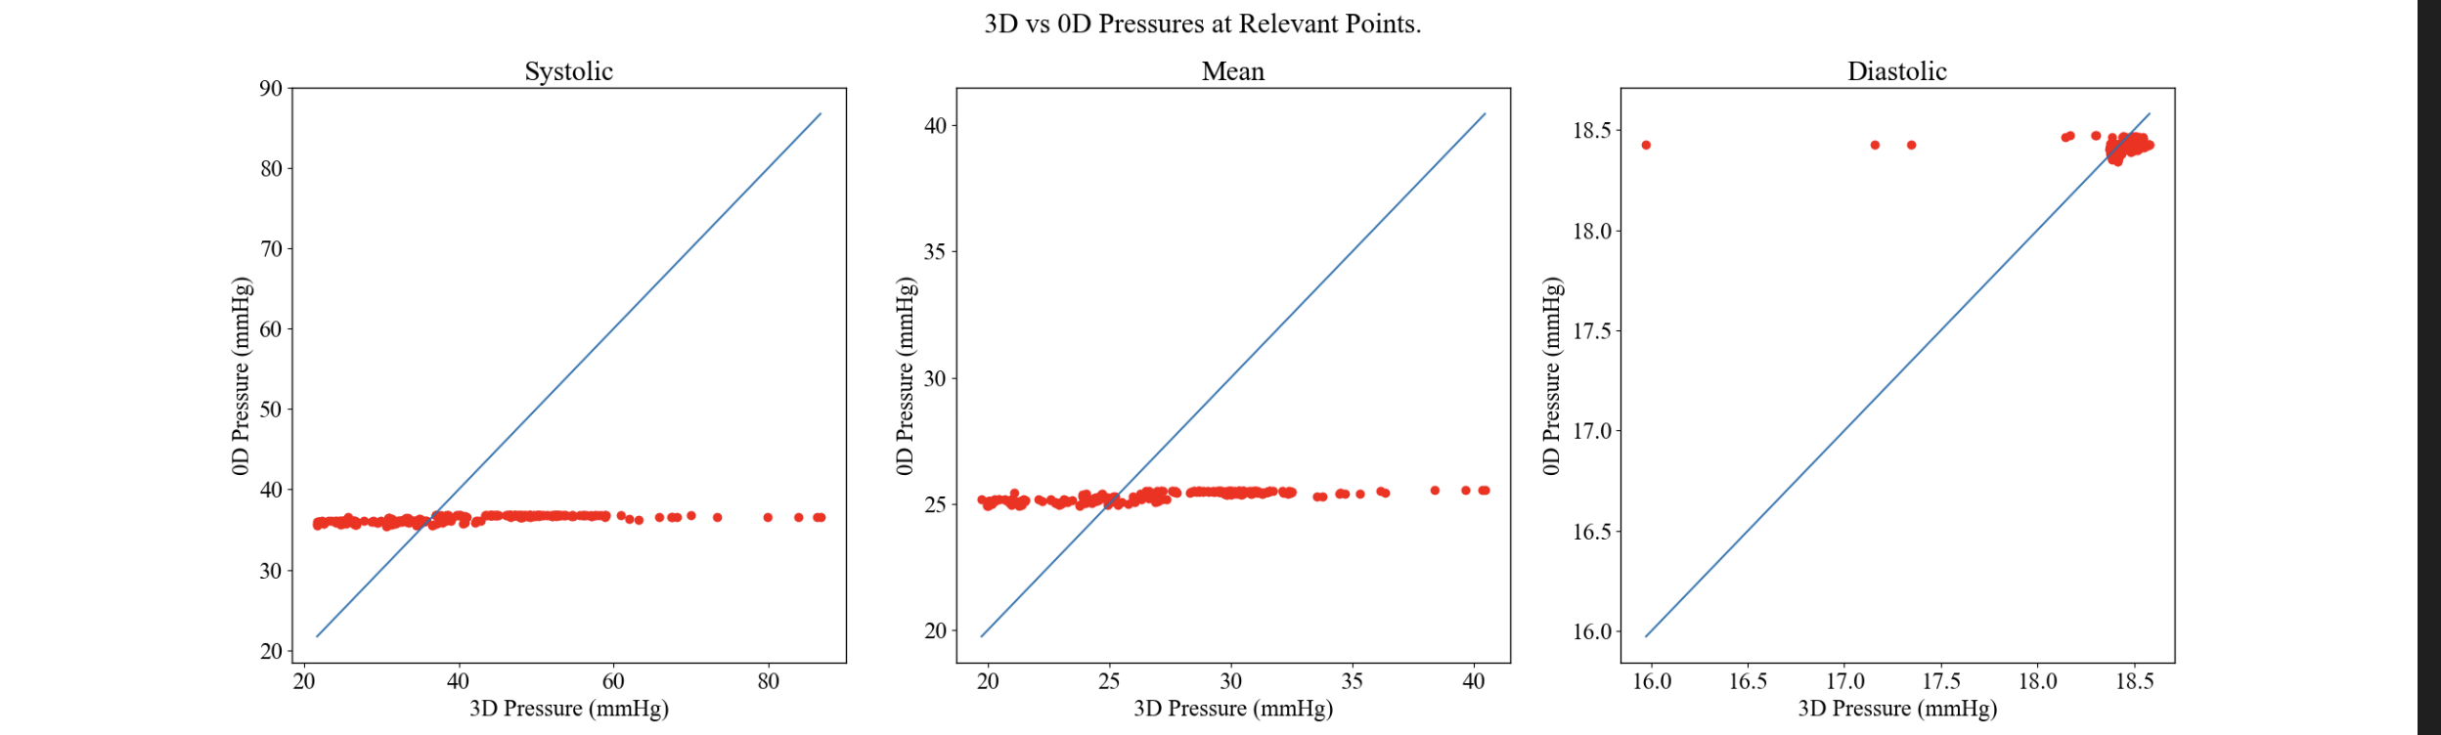
No correction

Slide 10
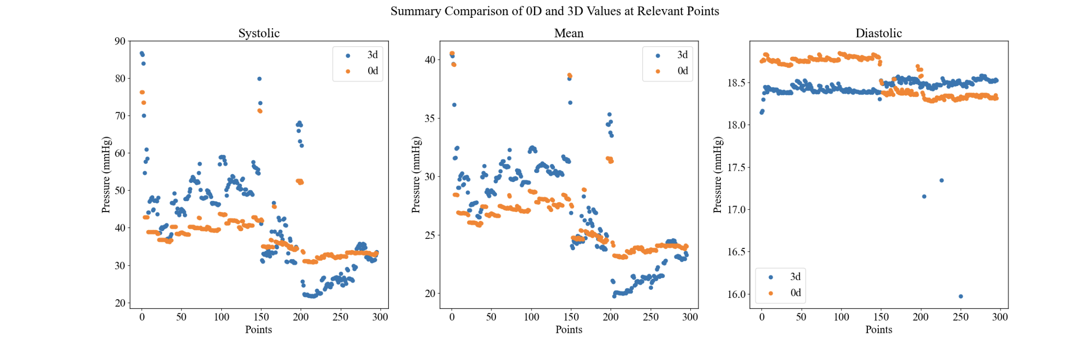
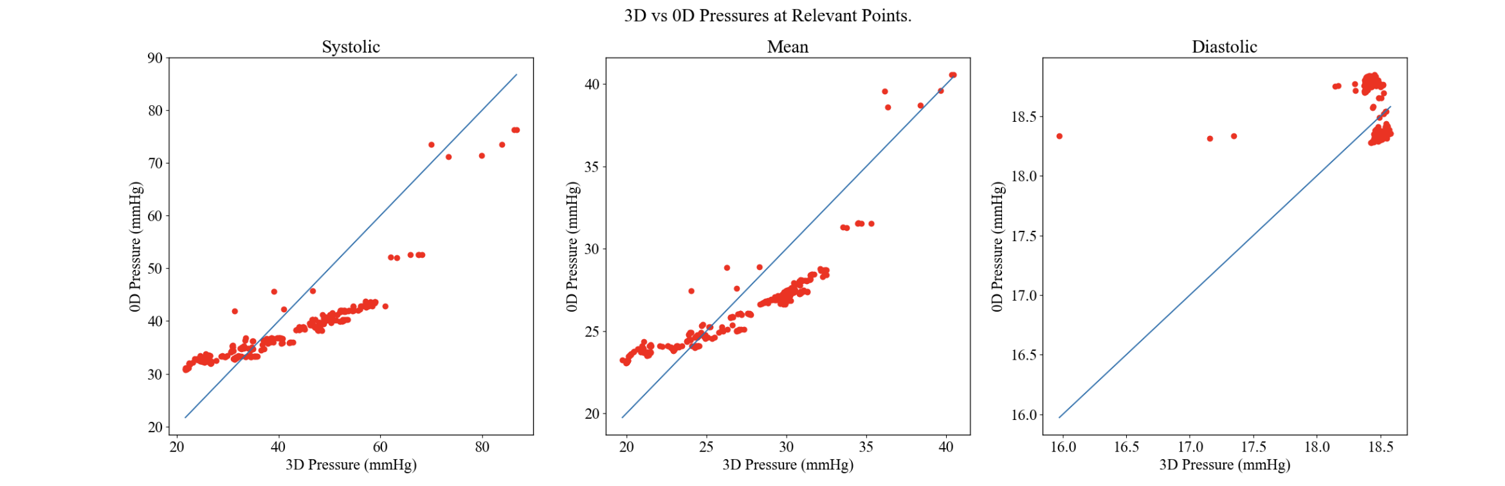
Unified correction

Slide 11
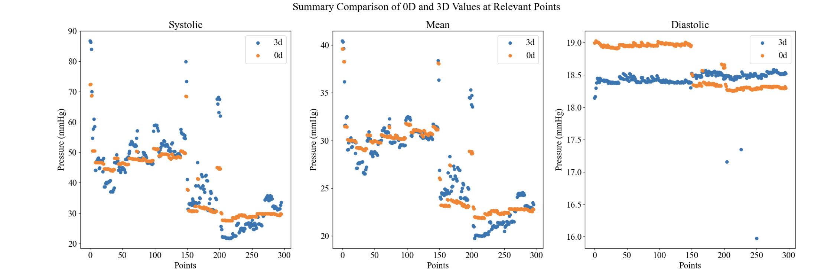
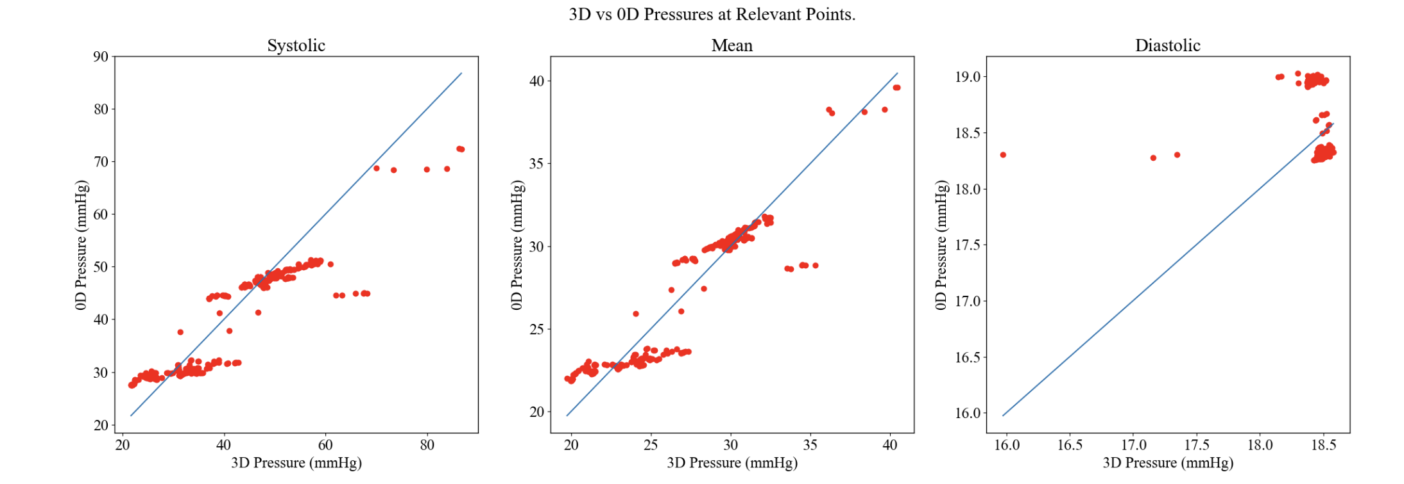
Split correction

Slide 12
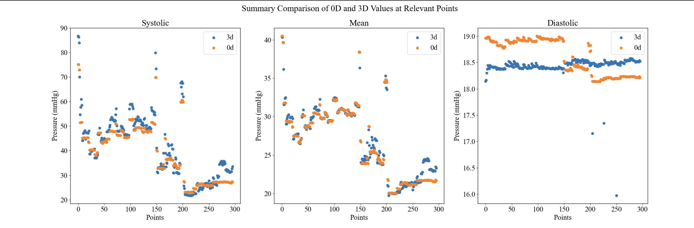
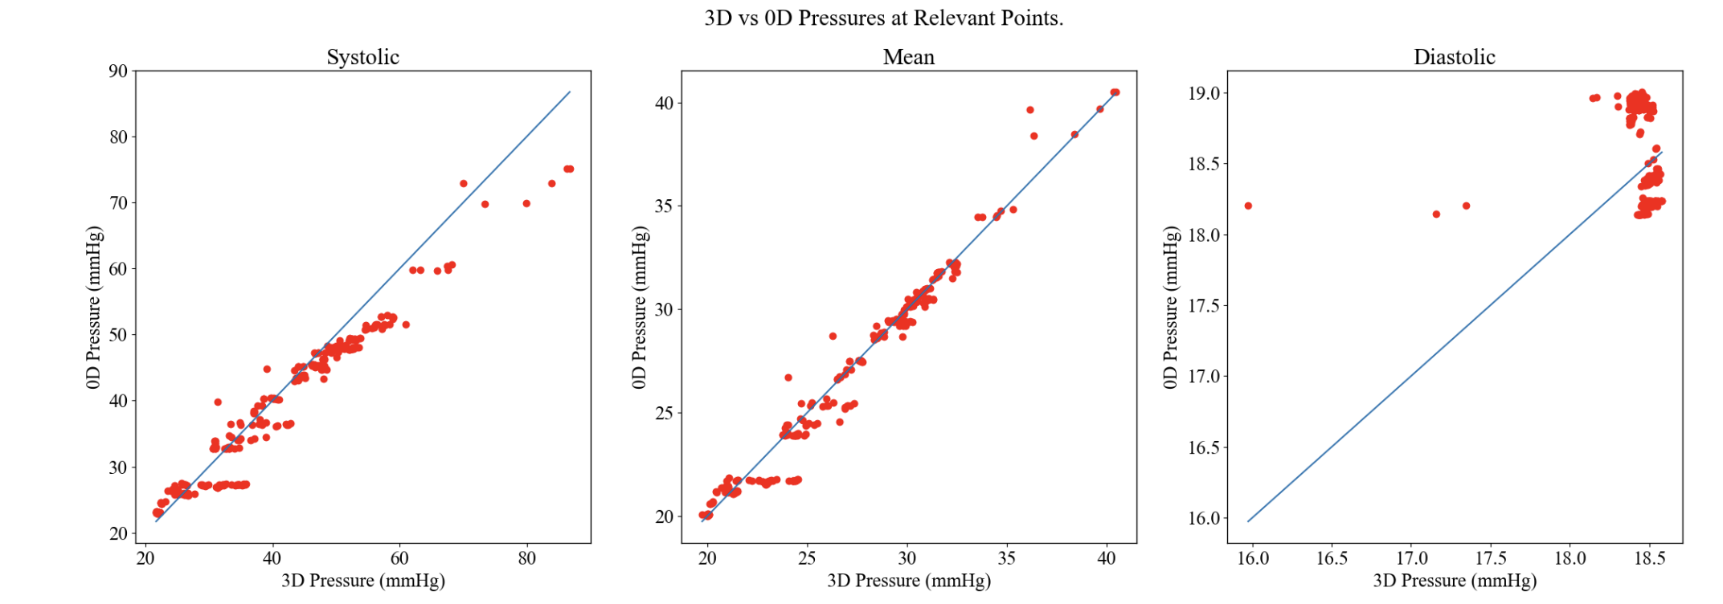
Split correction x5

Slide 13
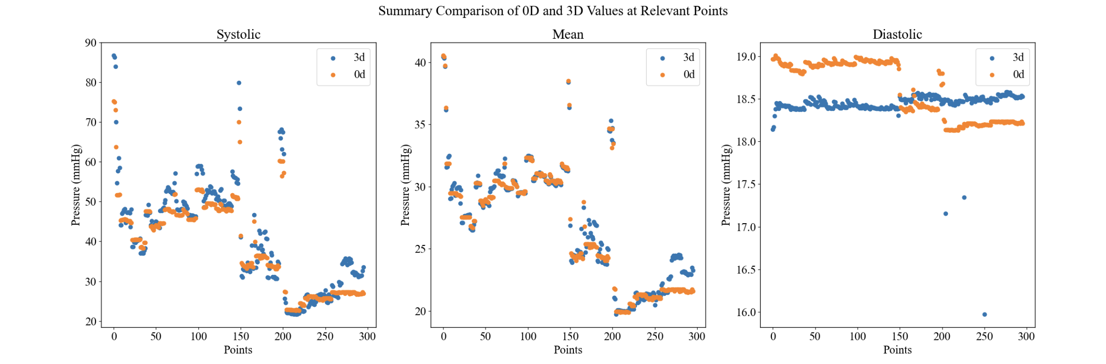
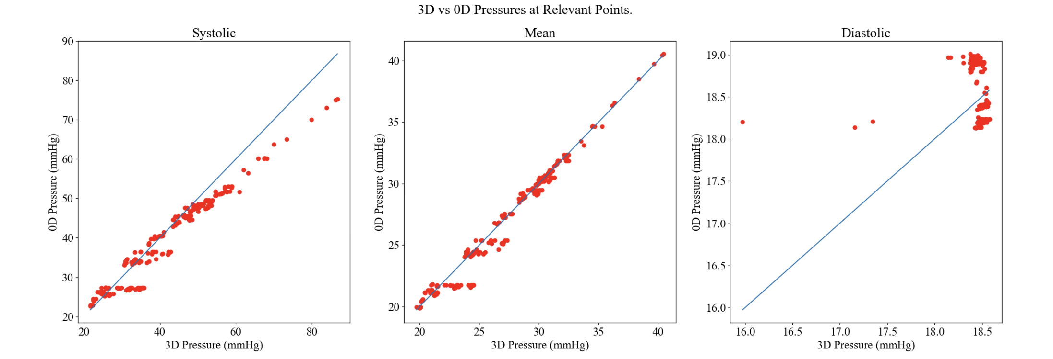
Split correction ALL x5

Slide 14
Discussion
We only tune for means w/ linear resistors, but the underestimation of Systolic pressures suggest nonlinearity or need to adjust capacitance
This means systolic measurements, particularly at higher pressures is inaccurate

Slide 15
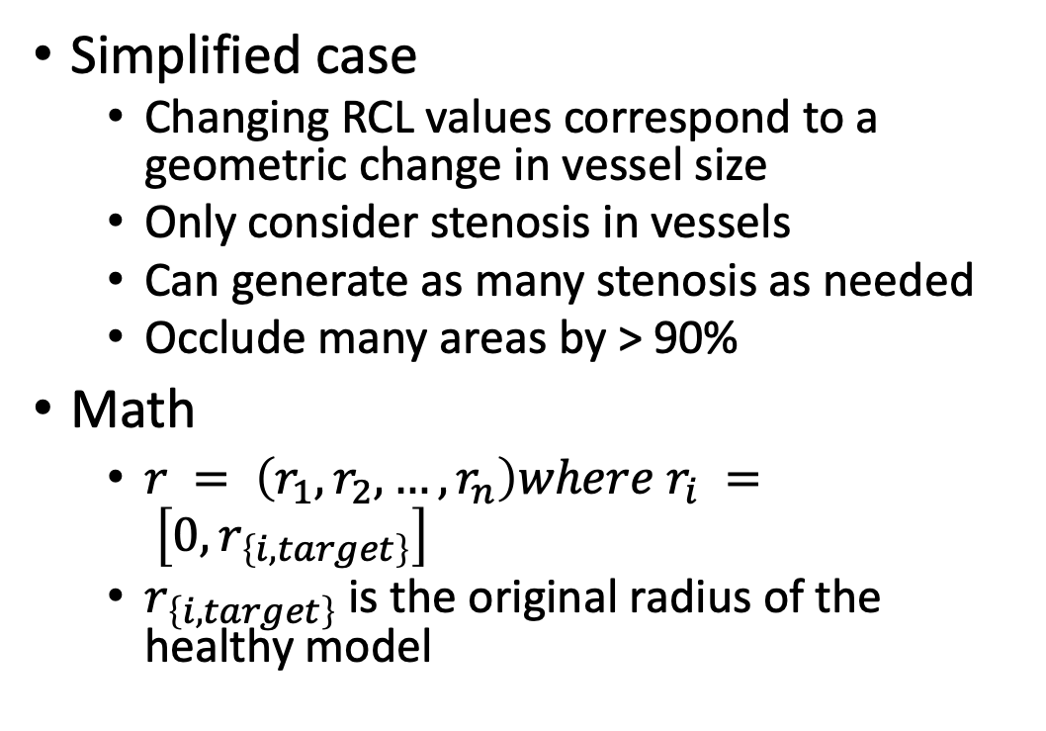
Artificial Stenosis (Simple Case)
Simplified case
Changing RCL values correspond to a geometric change in vessel size
Only consider stenosis in vessels
Can generate as many stenosis as needed
Occlude many areas by > 90%
Math
$r = \left(r_{1},r_{2},…,r_{n}\right)where r_{i} = \left[0,r_{\left\{i,target\right\}}\right]$
$r_{\left\{i,target\right\}}$ is the original radius of the healthy model

Slide 16
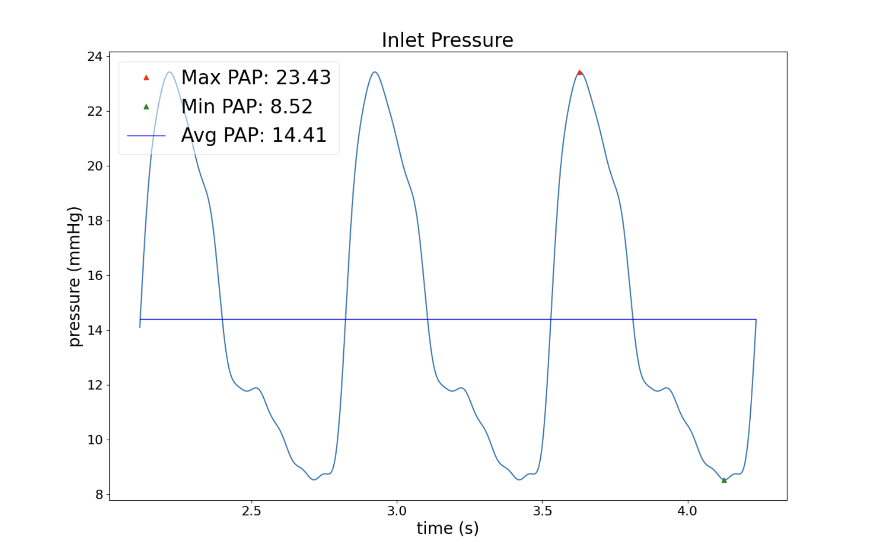
Problems in Parametrizing (Healthy)
Linear correction adds resistance to a JunctionVessel, rather than adding it to the downstream vessel
Modifying vessels alone is insufficient to cause a pressure change.
Overcome invariance with more stenosis points, since the healthy model only needs to demonstrate the neural network can handle high dimensional cases.
Extreme artificial stenosing-->

Slide 17
Parametrizing Stenosis(Diseased)
True stenosis is often in junctions (since there are so many junctional regions) →
For vessels, we don’t know how much to reduce the resistance by
For junctions, there is no inherent geometrical meaning to changing the resistance of a junction.

Slide 18
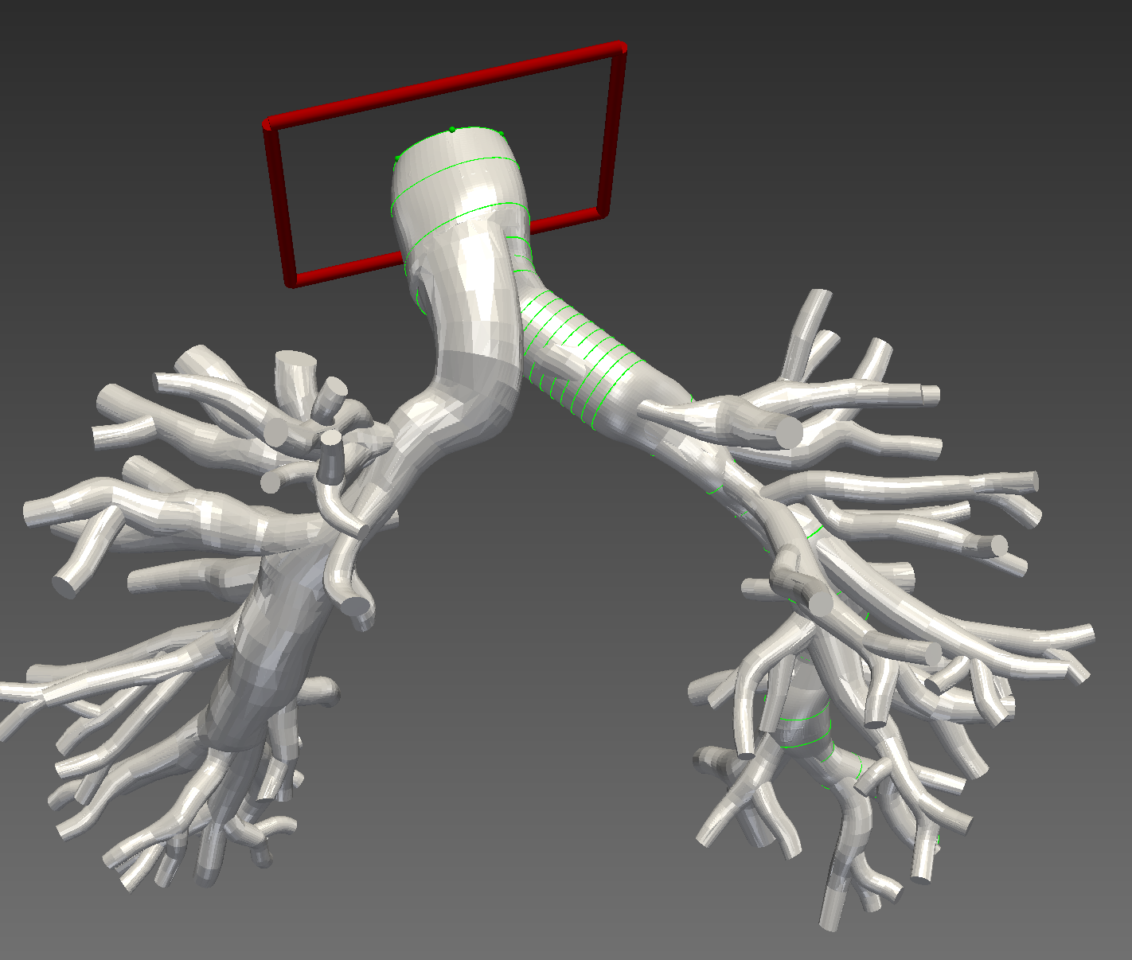
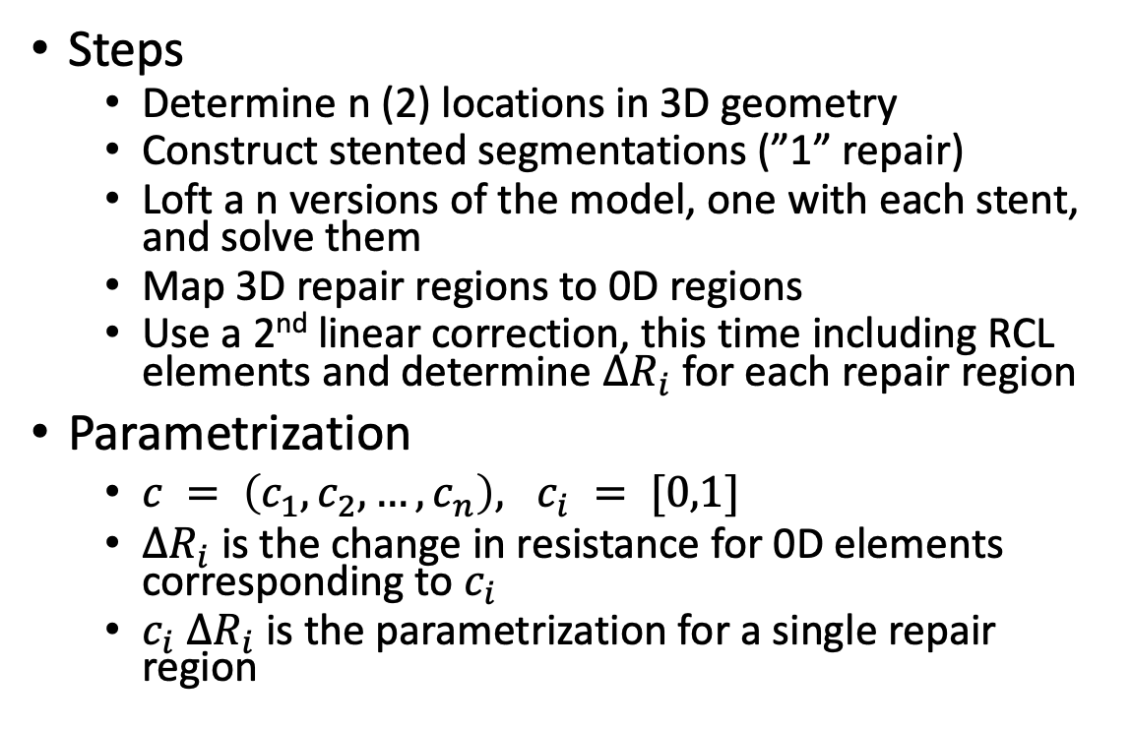
General Parametrizing Solution
Steps
Determine n (2) locations in 3D geometry
Construct stented segmentations (”1” repair)
Loft a n versions of the model, one with each stent, and solve them
Map 3D repair regions to 0D regions
Use a 2nd linear correction, this time including RCL elements and determine $ΔR_{i}$ for each repair region
Parametrization
$c = \left(c_{1},c_{2},…,c_{n}\right), c_{i} = [0,1]$
$ΔR_{i}$ is the change in resistance for 0D elements corresponding to $c_{i}$
$c_{i}$ $ΔR_{i}$ is the parametrization for a single repair region

Slide 19
Anticipated Challenges
Lofting 3D model (May need assistance with this)
We managed to loft 3 valid 3D stented models and solved them
Will the centerlines correspond when mapping the 3D solutions, since stenting changes 3D geometry?
We mapped the stented centerlines to the pre-stented centerlines, but there should not be many problems
Identifying the regions where the stenting covers in the 0D model
This is relevant only if we choose to limit the region of linear correction.
Will the second linear correction cause odd behaviors?
In Progress

Slide 20
Global Corrections

Slide 21
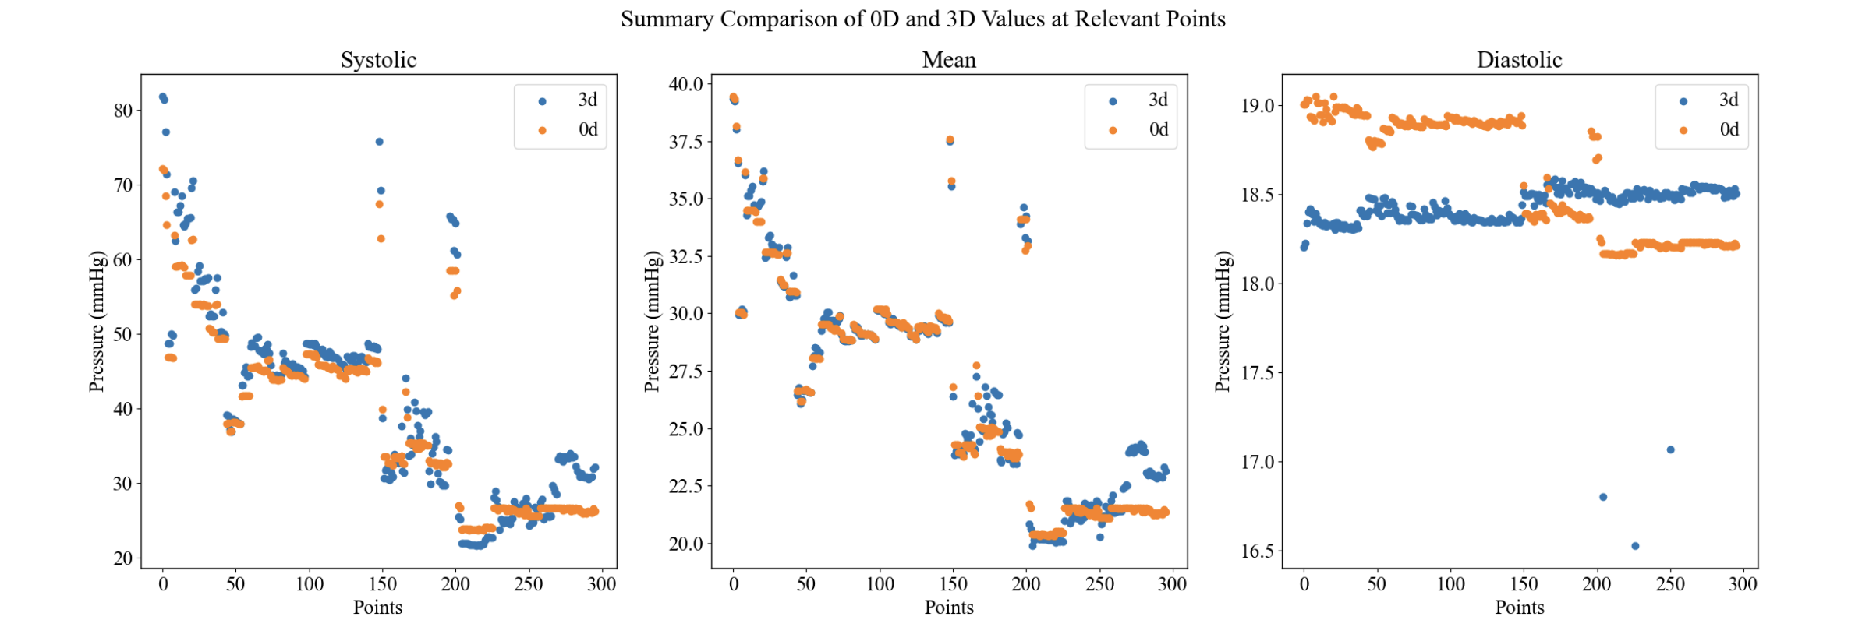
LPA

Slide 22
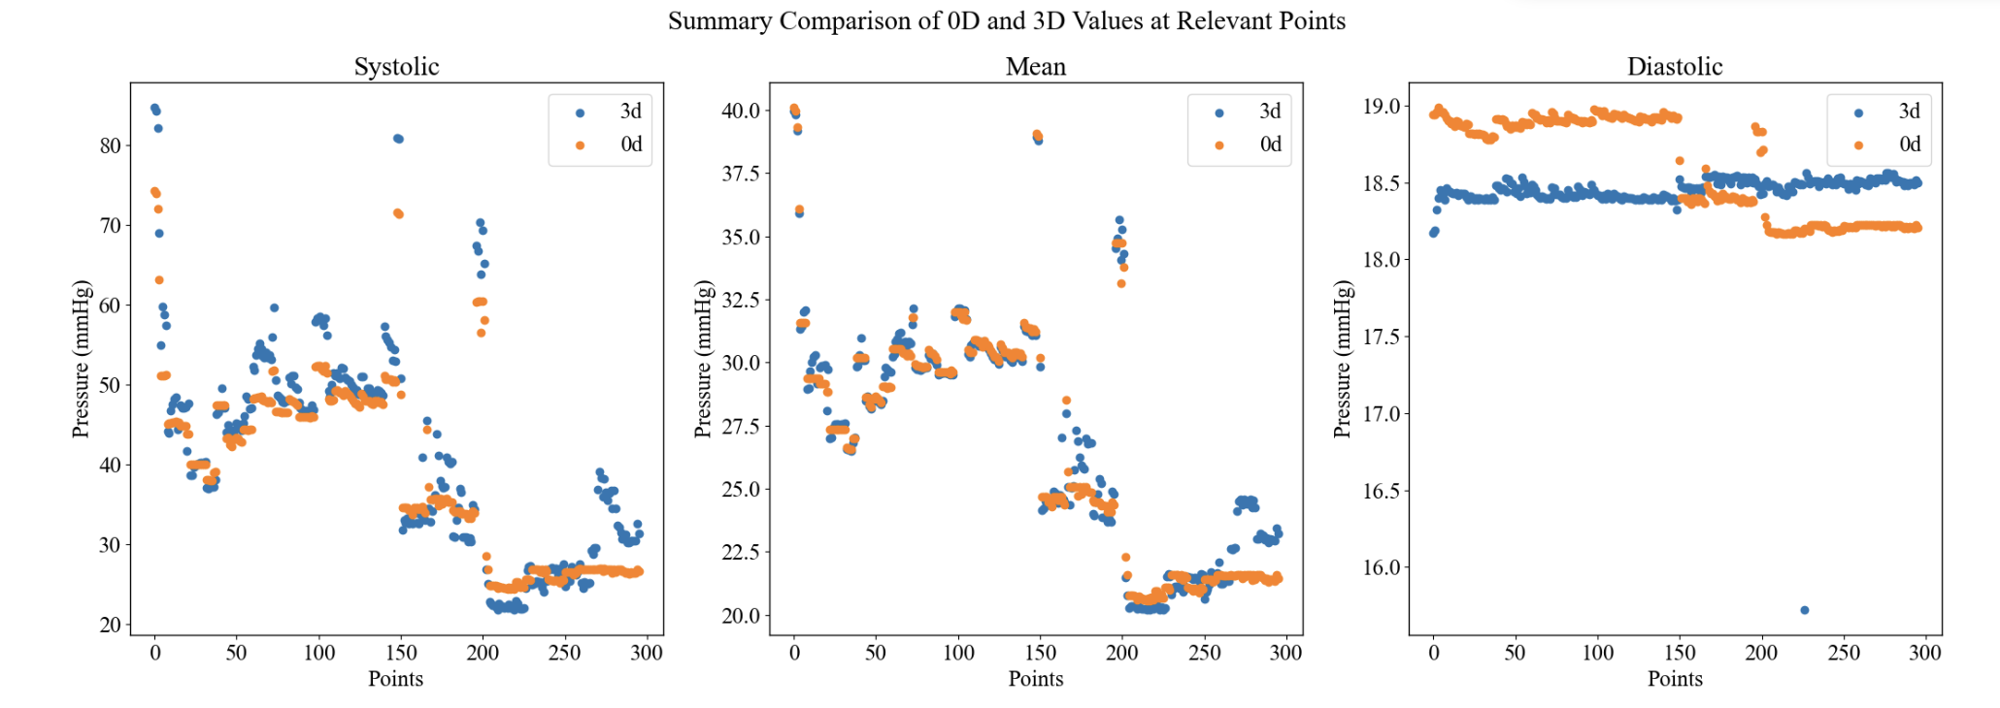
RPA

Slide 23
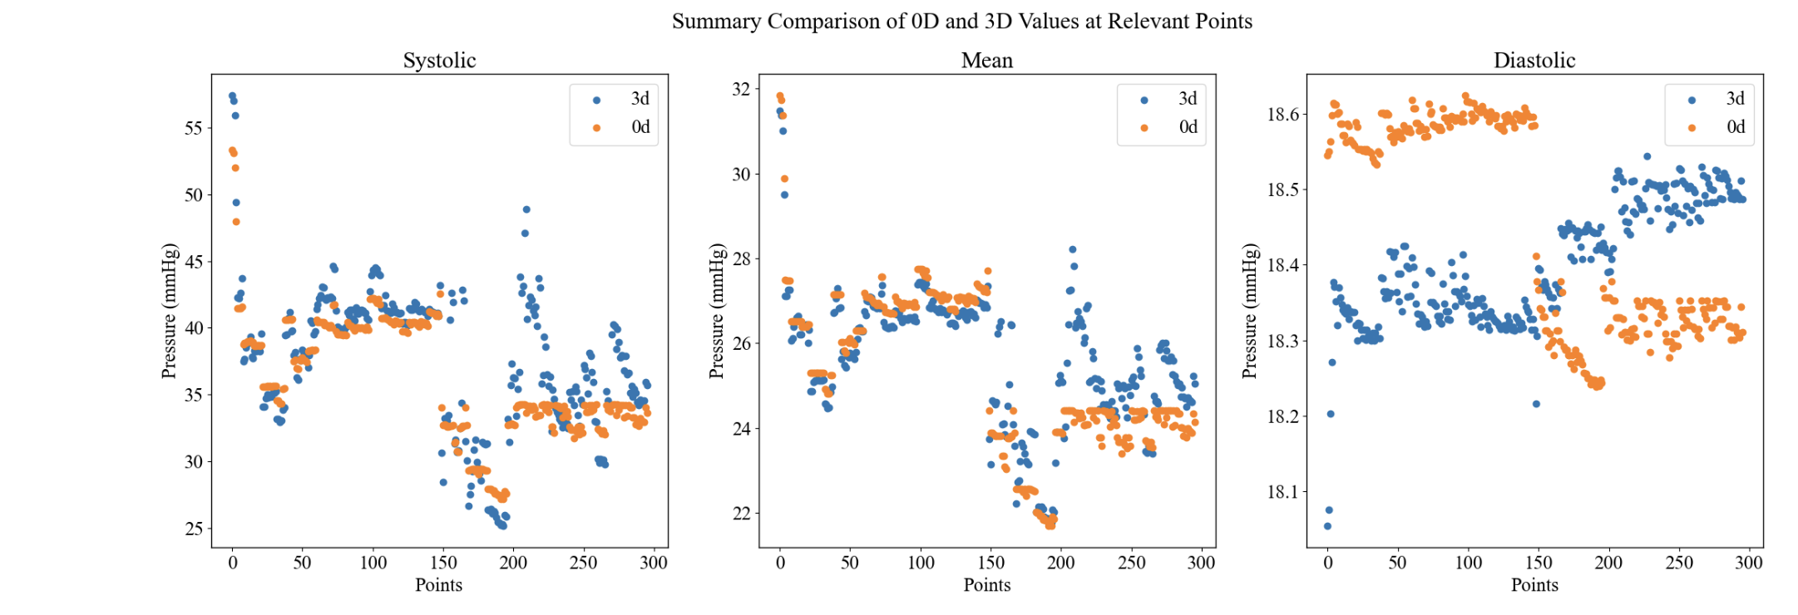
RPA2

Slide 24
Local Corrections

Slide 25
Method
Take diseased and stented centerlines
Sort all relevant point on the stented centerlines by their distance from the corresponding point on the diseased centerlines.
Set a distance cutoff at points 2 std above average and only correct points with distances above that cutoff
Corrects all resistances in a junction, rather than only the mapped outlet.

Slide 26
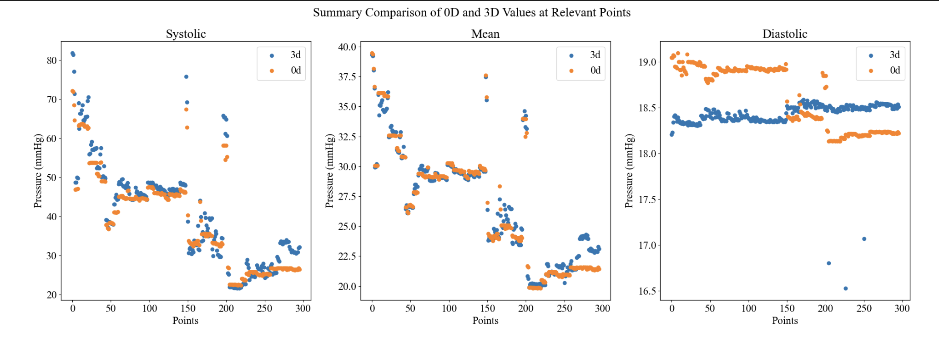
LPA_limited

Slide 27
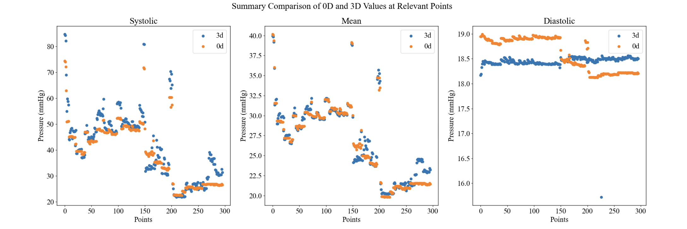
RPA_limited

Slide 28
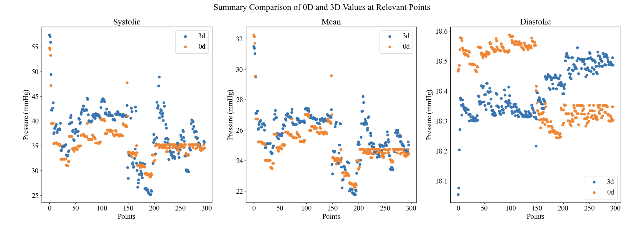
RPA2_limited

Slide 29
Discussion on RPA2
After performing a limited linear correction on RPA2, I noticed that despite not modifying any global boundary conditions, we could achieve significantly lower pressures simply by changing the resistances in the specified regions
This suggests RPA2 may in fact be valid
However, the linear correction is much more inaccurate, likely due to the fact that no correction occurs on the LPA at all resulting in the pressure difference on the left side.

Slide 30
Parameterization

Slide 31
Problem
Suppose for <c1,c2,c3> which represent the parameterization of our 3 repair regions, where ci goes from 0 to 1.
It is mathematically possible (and does occur) that dR1 + dR2 + dR3 is less than 0, meaning when ai = 1 there is non-physical resistances

Slide 32
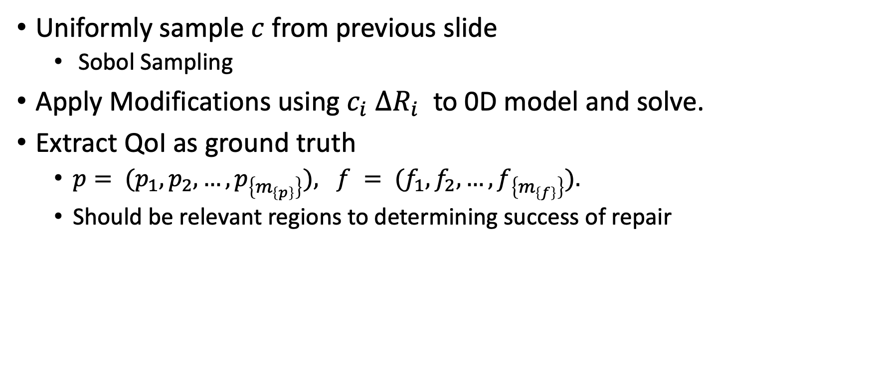
Training Data Generation
Uniformly sample $c$ from previous slide
Sobol Sampling
Apply Modifications using $c_{i}$ $ΔR_{i}$ to 0D model and solve.
Extract QoI as ground truth
$p= (p_{1},p_{2},…,p_{\left\{m_{\left\{p\right\}}\right\}}), f = (f_{1},f_{2},…,f_{\left\{m_{\left\{f\right\}}\right\}}).$
Should be relevant regions to determining success of repair

Slide 33
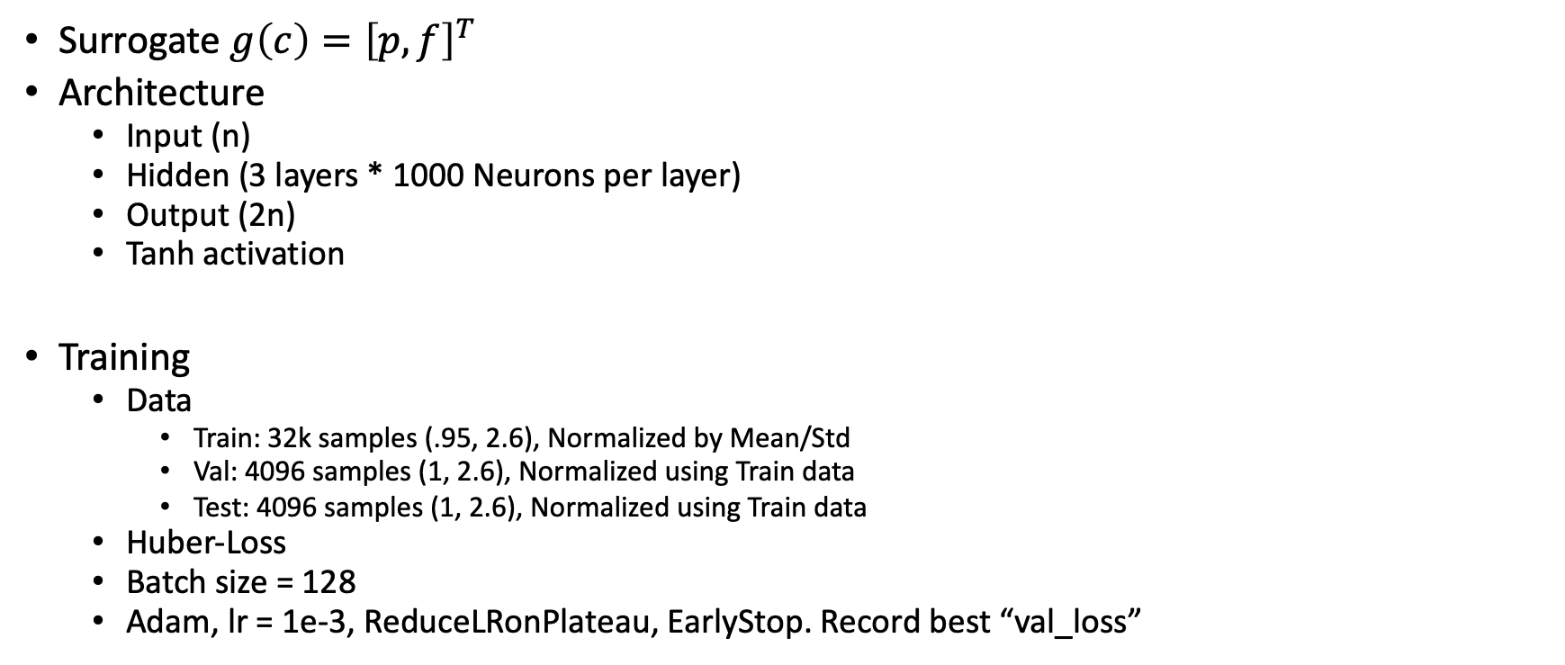
Neural Network
Surrogate $g\left(c\right)={\left[p, f\right]}^{T}$
Architecture
Input (n)
Hidden (3 layers * 1000 Neurons per layer)
Output (2n)
Tanh activation
Training
Data
Train: 32k samples (.95, 2.6), Normalized by Mean/Std
Val: 4096 samples (1, 2.6), Normalized using Train data
Test: 4096 samples (1, 2.6), Normalized using Train data
Huber-Loss
Batch size = 128
Adam, lr = 1e-3, ReduceLRonPlateau, EarlyStop. Record best “val_loss”

Slide 34
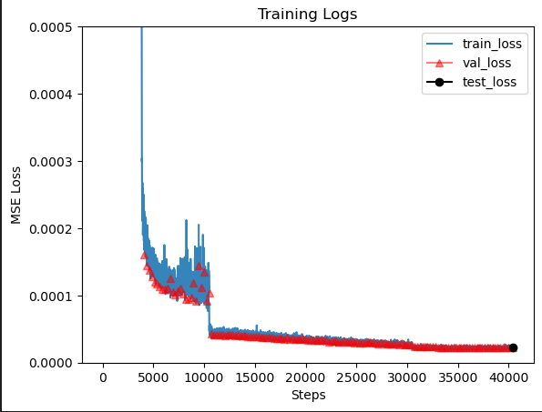
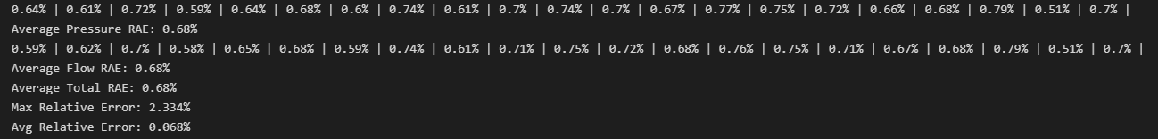

Slide 35
Additional Work
Most of the framework for NN/Training is done.
Dimensionality
Previously demonstrated the NN’s capability for high dimensional solutions (> 30 repair regions)
Do we need to design a method for a more efficient NN? With only 2 repair regions, the current model may be significantly overkill.
New errors corresponding to prior changes.

Slide 36
Probabilistic Modeling for Clinical Question
NN can be used to determine conditional and marginal probabilities efficiently
We can use it to solve relevant problems
Ex. Optimal repair path

